Slide 1
Software Development Proposal
By Beau Rolland

Slide 2
Introduction to Scrum-Agile
Scrum-Agile provides an approach to software development that allows teams to incorporate feedback and adjust requirements as a project progresses.

Slide 3
Purpose and Project Context
Project goal: Develop the SNHU Travel application using the scrum agile framework
Current approach: ChadaTech has traditionally used the Waterfall development model.
Proposed change: Evaluate whether Scrum-Agile can improve flexibility, collaboration, and responsiveness to customer feedback.
Presentation objective: Compare the approaches and recommend which would best support ChadaTech's development projects.

Slide 4
Agile Roles
Product Owner
  Defines product goals and prioritizes the product backlog.
  Ensures development focuses on customer needs.
Scrum master
  Facilitates Scrum events and supports Scrum practices.
  Helps identify obstacles and improve team effectiveness.
Developer
  Designs, builds, and maintains the application's functionality.
  Works toward delivering a usable product increment each sprint.
Tester
  Develops and performs tests to verify expected functionality.
  Identifies defects and clarifies requirements to help ensure the product meets acceptance criteria.
(Coleman, 2023; ISTQB, 2023)

Slide 5
Agile Development Cycle
Planning and Requirements: Identify customer needs and prioritize user stories.
Design: Determine how the feature will work and fit into the application.
Development: Build the functionality selected for the sprint.
Testing: Verify that the feature works as expected and meets acceptance criteria.
Deployment and Review: Deliver a usable increment and gather feedback.
Maintenance: Fix issues and continue improving the application.
Key takeaway: Agile repeats these activities across iterations, allowing the team to incorporate feedback and adjust requirements as development progresses.
(Madaan, 2024)

Slide 6
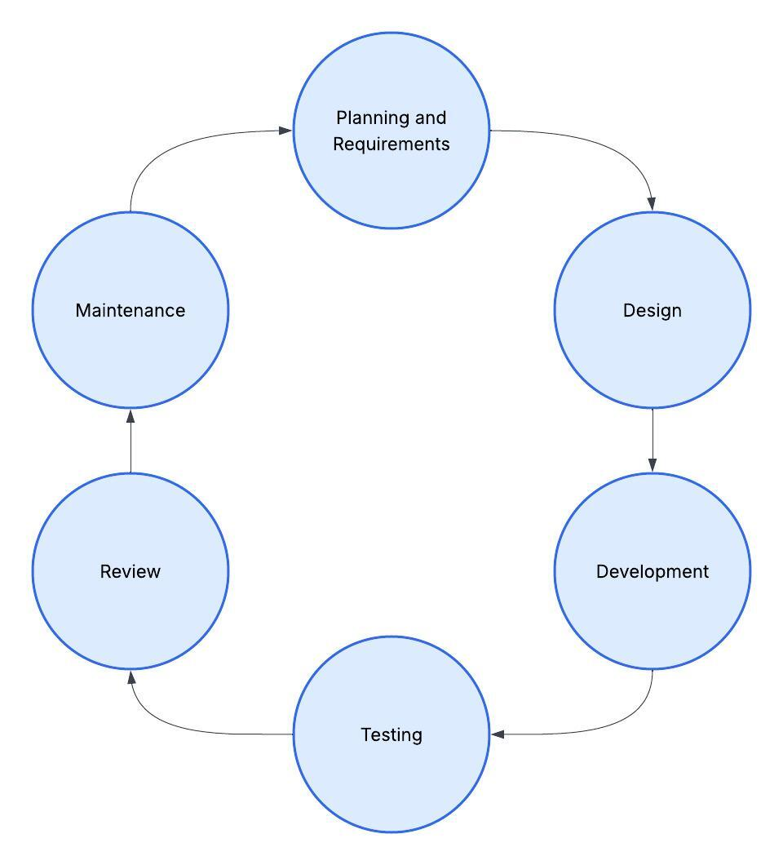
Agile Development Cycle

Slide 7
Waterfall Vs. Agile
Waterfall
Agile
Phases completed in sequence
Requirements established upfront
Testing follows development
Changes may require rework
Work completed in iterations
Requirements refined as needed
Testing throughout development
Changes managed as priorities evolve
Agile would allow the team to adjust the project as requirements change, while Waterfall would make late changes more difficult to accommodate.
(Madaan, 2024)

Slide 8
Application in SNHU Travel
User Stories: Break application requirements into manageable features.
Sprint Development: Develop and improve features in small increments.
Testing: Verify functionality and identify defects throughout development.
Feedback and Changes: Adjust the application when requirements need clarification or change.
Key takeaway: Scrum-Agile supports incremental development, ongoing testing, and adjustments based on project needs.
(ISTQB, 2023)

Slide 9
Recommendation
High-Level Planning: Use Waterfall to establish project goals, scope, and major milestones.
Agile Development: Use Scrum-Agile to develop features incrementally and adapt to changing requirements.
Continuous Testing: Incorporate testing and feedback throughout development.
Team Collaboration: Use Scrum events to maintain communication and address obstacles.
Final Recommendation: ChadaTech should adopt a hybrid approach that combines Waterfall's structured planning with Scrum-Agile's flexibility, allowing teams to maintain clear project goals while adapting to changing customer needs.
(Reiff & Schlegel, 2022)

Slide 10
References
Coleman, J. (2023, April 25). Should a Scrum Master become a Product Owner? Scrum.org. https://www.scrum.org/resources/blog/should-scrum-master-become-product-owner
International Software Testing Qualifications Board. (2023). Certified tester foundation level syllabus (Version 4.0). https://www.istqb.org/certifications/certified-tester-foundation-level-ctfl-v4-0/
Madaan, K. (2024, April 30). Waterfall-ish playbook: How Jira Align helps traditional projects and portfolios succeed. Inside Atlassian. https://www.atlassian.com/blog/jira-align/bringing-agility-to-project-mgmt
Reiff, J., & Schlegel, D. (2022). Hybrid project management: A systematic literature review. International Journal of Information Systems and Project Management, 10(2), 45–63. https://doi.org/10.12821/ijispm100203

